Slide 1

http://flic.kr/p/9RR1BL
Domain Modeling

Slide 2
SWEBOK Knowledge Areas
Software Requirements
Software Design
Software Construction
Software Testing
Software Maintenance
Software Configuration Management
Software Engineering Management
Software Engineering Process
Software Engineering Models and Methods
Software Quality
Software Engineering Professional Practice
Software Engineering Economics
Computing Foundations
Mathematical Foundations
Engineering Foundations
Today’s topic: Analysis

Slide 3
Challenges: From Requirements to Design
Developer not problem domain expert
Lacks mental model
User stories not unified model
Can't see the forest for the trees
Representational gap b/t requirements and design
USs are text descriptions of features
OO designs are interrelated classes of objects

Slide 4

Analysis bridges the gap between requirements and design
Design
http://flic.kr/p/a1NZHb
Analysis
Requirements

Slide 5
Domain Model
Captures entities, attributes, and relationships in the problem domain
Represented with UML class diagram
Conceptual classes not software classes
Inspiration for software classes
Lowers representational gap
Key rationale for OOP

Slide 6
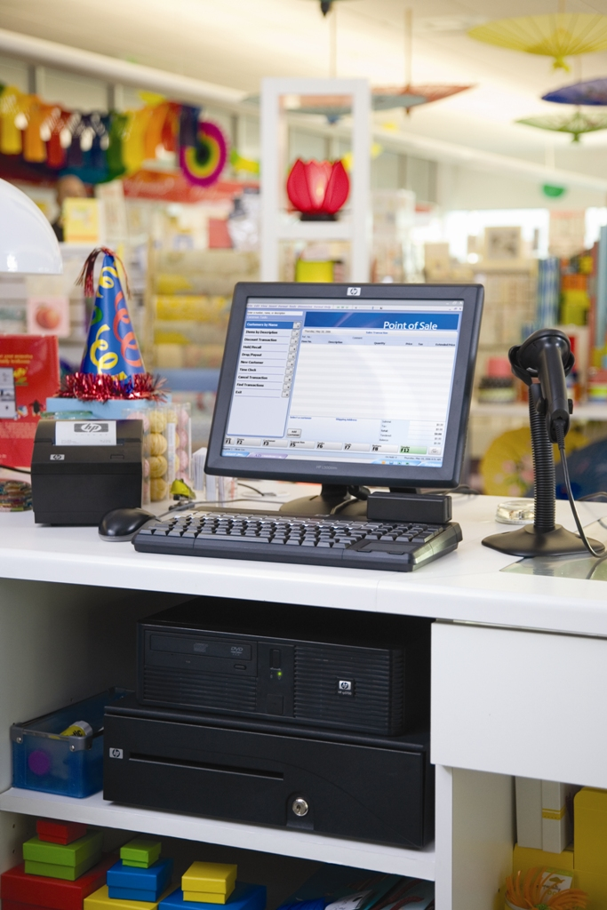
Example: Point-of-Sale (POS) System
http://flic.kr/p/4UtQzk

Slide 7
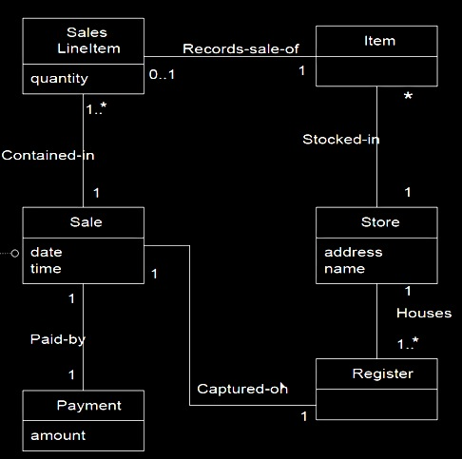
POS Domain Model
Classes: concepts or entities in the problem domain (not software)

Slide 8
POS Domain Model
Classes: concepts or entities in the problem domain (not software)
Attributes: number or text properties of conceptual classes

Slide 9
Is it a class or an attribute?
Objects have identity
Two objects w/ same attribute values are still distinct
Model as classes
Data values do not have identity
Numbers, strings, dates, etc. with same value are same
Model as attributes

Slide 10
POS Domain Model
Classes: concepts or entities in the problem domain (not software)
Attributes: number or text properties of conceptual classes

Slide 11
POS Domain Model
▶
Classes: concepts or entities in the problem domain (not software)
▶
▶
Attributes: number or text properties of conceptual classes
▶
▶
Associations: relationships between classes
▶

Slide 12
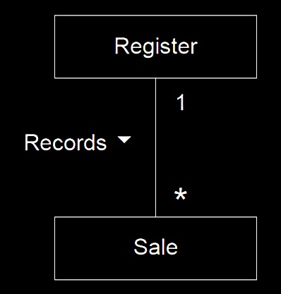
Associations
Reading direction
Multiplicities: Read as
each Register records 0 or more Sales
each Sale is recorded by exactly 1 Register
Name

Slide 13
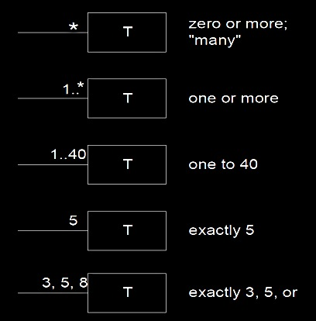
Examples of multiplicities
Also common to see 0..*
8

Slide 14
POS Domain Model
▶
Classes: concepts or entities in the problem domain (not software)
▶
▶
Attributes: number or text properties of conceptual classes
▶
▶
Associations: relationships between classes
▶

Slide 15
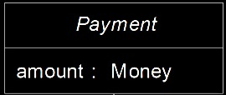
Consider the Payment class
Payment
There are different types of payments, like cash, credit, and check payments, and each type has some unique attributes
How would you model the different payment types?

Slide 16
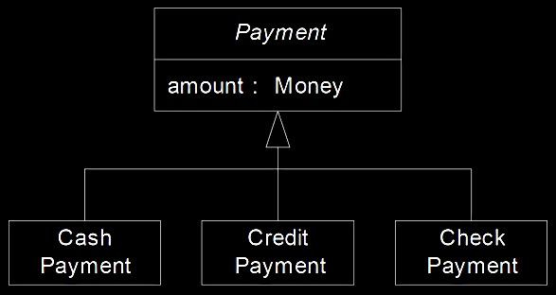
Answer: Use generalization
superclass – more general concept
Payment
generalization relationship (3 overlapping triangle-arrows)
subclasses – more specialized concepts

Slide 17
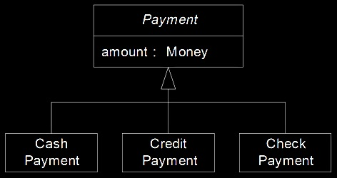
Generalization guideline: The 100% Rule
100% of the superclass’s definition should be applicable to the subclass
The subclass must conform to 100% of the superclass’s
attributes
associations
Payment

Slide 18
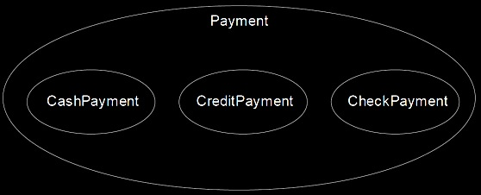
Generalization guideline: The Is-a Rule
All members of the subclass set must be members of the superclass set
Informal test: “A Subclass is a superclass”
E.g.: “A CashPayment is a Payment”
Remember this!!!

Slide 19
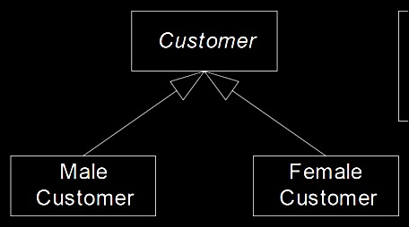
When to model subclasses?
Would you model this?

Slide 20
Guideline: Model a subclass when…
subclass has additional attributes of interest
AND/OR
subclass has additional associations of interest
AND/OR
subclass is operated on, handled, reacted to, or manipulated differently in ways that are of interest
AND/OR
subclass represents an animate thing (e.g., animal) that behaves differently in ways that are of interest

Slide 21
Payment
You can have cash, credit, and check payments, but can you ever really have just a Payment?

Slide 22
No. Payment is what we call an abstract class as opposed to a concrete class
abstract
Payment
concrete

Slide 23
Abstract class indicated by italics

Slide 24
… or when drawing by hand use
Payment
Payment {abstract}

Slide 25
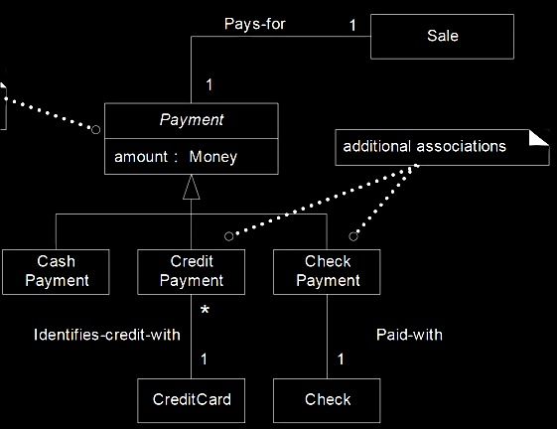
POS Example: Generalization
Does this model obey:
The 100% Rule?
The Is-a Rule?

Slide 26
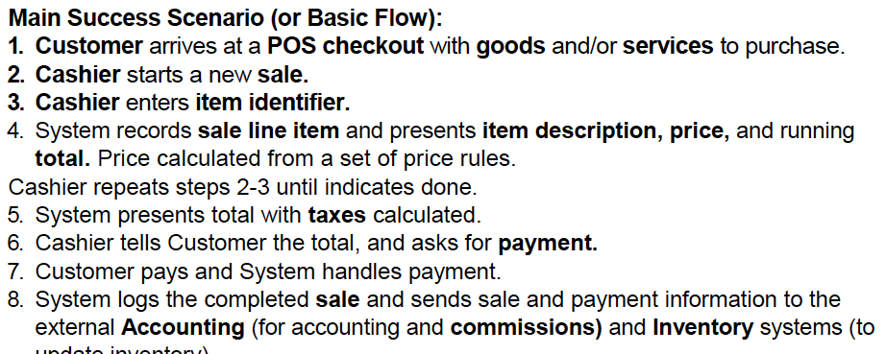
How to find conceptual classes and attributes: Noun phrase identification
Identify nouns and noun phrases in descriptions of a domain (e.g., USs)
Nouns = candidate classes or attributes

Slide 27
What about Verb Phrases?
has-a can refer to association or attribute
is-a often refers to generalization

Slide 28

Tip: Think like a mapmaker
Use existing names in the territory
No irrelevant or out-of-scope features
Do not add things
http://flic.kr/p/5QKvWh

Slide 29

Summary
Domain modeling / OO analysis
Associations / multiplicities
Object identity vs data values
Generalization relationships
Abstract classes
Noun phrase identification technique
http://flic.kr/p/aCLor3

Slide 30
Appendix

Slide 31
Activity: Create a Domain Model for Your Project
Identify nouns and noun phrases—for inspiration
USs are good starting place
Collaboratively sketch class diagram
Use as inspiration for MVC Model class design

Slide 32
POS Domain Model
How many Stores can an Item be stocked in?
How many Items can a Store stock?
How many Registers does a Store house?
How many Sales LineItems per Sale?
How many Sales LineItems can a particular Item be recorded in?

